Slide 1
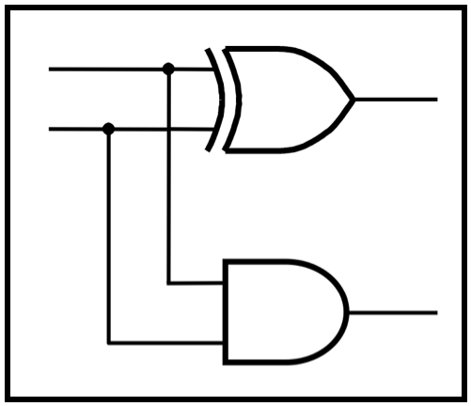
CprE 281:
Digital Logic
Instructor: Alexander Stoytchev
http://www.ece.iastate.edu/~alexs/classes/

Slide 2
Registers
CprE 281: Digital Logic
Iowa State University, Ames, IA
Copyright © Alexander Stoytchev

Slide 3
Administrative Stuff
The second midterm is next Friday.
Homework 8 is due next Monday.

Slide 4
Administrative Stuff
Midterm Exam #2
When: Friday October 28 @ 4pm.
Where: This classroom
What: Chapters 1, 2, 3, 4 and 5.1-5.8
The exam will be open book and open notes (you can bring up to 3 pages of handwritten notes).

Slide 5
Midterm 2: Format
The exam will be out of 130 points
You need 95 points to get an A
It will be great if you can score more than 100 points.
  but you can’t roll over your extra points ☹

Slide 6
Midterm 2: Topics
Binary Numbers and Hexadecimal Numbers
1’s complement and 2’s complement representation
Addition and subtraction of binary numbers
Circuits for adders and fast adders
Single and Double precision IEEE floating point formats
Converting a real number to the IEEE format
Converting a floating point number to base 10
Multiplexers (circuits and function)
Synthesis of logic functions using multiplexers
Shannon’s Expansion Theorem

Slide 7
Midterm 2: Topics
Decoders (circuits and function)
Demultiplexers
Encoders (binary and priority)
Code Converters
K-maps for 2, 3, and 4 variables
Synthesis of logic circuits using adders, multiplexers, encoders, decoders, and basic logic gates
Synthesis of logic circuits given constraints on the available building blocks that you can use
Latches (circuits, behavior, timing diagrams)
Flip-Flops (circuits, behavior, timing diagrams)
Registers and Register Files

Slide 8
Review of Flip-Flops

Slide 9
A simple memory element with NOT Gates
x
x
x

Slide 10
A simple memory element with NAND Gates
x
x
x

Slide 11
A simple memory element with NOR Gates
x
x
x

Slide 12
Basic Latch

Slide 13
A simple memory element with NOR Gates

Slide 14
A simple memory element with NOR Gates

Slide 15
A simple memory element with NOR Gates
Set
Reset

Slide 16
A memory element with NOR gates
Reset
Set
Q
[ Figure 5.3 from the textbook ]

Slide 17
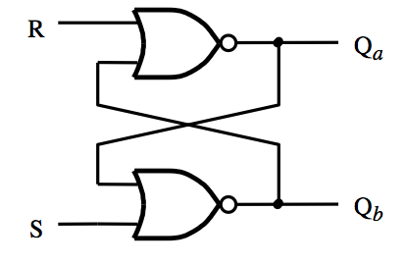
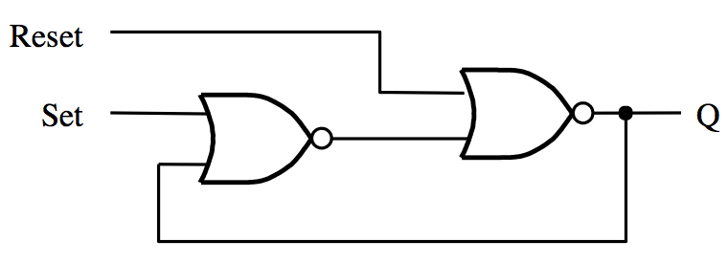
Two Different Ways to Draw the Same Circuit
[ Figure 5.3 & 5.4 from the textbook ]

Slide 18
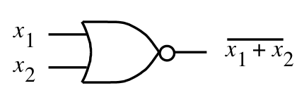
SR Latch: Circuit and Truth Table
R
S
R
Q
Q
Q
a
b
a
0
0
0/1 1/0
(no change)
0
1
0
1
1
0
1
0
Q
1
1
0
0
(Undesirable)
S
b
(a) Circuit
(b) Truth table
[ Figure 5.4a,b from the textbook ]
NOR Gate Truth table
NOR Gate
x₁ | x₂ | f
0 | 0 | 1
0 | 1 | 0
1 | 0 | 0
1 | 1 | 0

Slide 19
Gated SR Latch

Slide 20
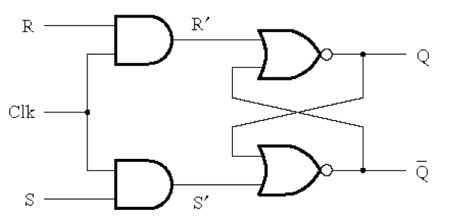
Circuit Diagram for the Gated SR Latch
[ Figure 5.5a from the textbook ]

Slide 21
Circuit Diagram for the Gated SR Latch
This is the “gate”
of the gated latch

Slide 22
Circuit Diagram for the Gated SR Latch
Notice that these are complements of each other

Slide 23
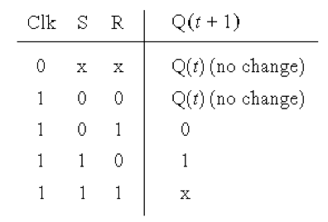
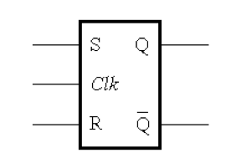
Gated SR Latch: Circuit Diagram, Characteristic Table, and Graphical Symbol
(Undesirable)
[ Figure 5.5 from the textbook ]

Slide 24
Gated SR latch with NAND gates
S
Q
Clk
Q
R
[ Figure 5.6 from the textbook ]

Slide 25
Gated SR latch with NAND gates
S
Q
Clk
Q
R
In this case the “gate” is constructed using NAND gates! Not AND gates.

Slide 26
Gated SR latch with NAND gates
S
Q
Clk
Q
R
Also, notice that the positions of S and R are now swapped.

Slide 27
Gated SR latch with NAND gates
S
S
1
Q
Clk = 1
1
Q
R
R
Finally, notice that when Clk=1 this turns into the
basic latch with NAND gates, i.e., the SR Latch.

Slide 28
Gated SR latch with NOR gates
Gated SR latch with NAND gates
S
Q
Clk
Q
R

Slide 29
Gated SR latch with NOR gates
Gated SR latch with NAND gates
S
Q
Clk
Q
R
Graphical symbols are the same

Slide 30
Gated SR latch with NOR gates
(undesirable)
Gated SR latch with NAND gates
S
Q
Clk
Q
(undesirable)
R
Characteristic tables are the same

Slide 31
Gated D Latch

Slide 32
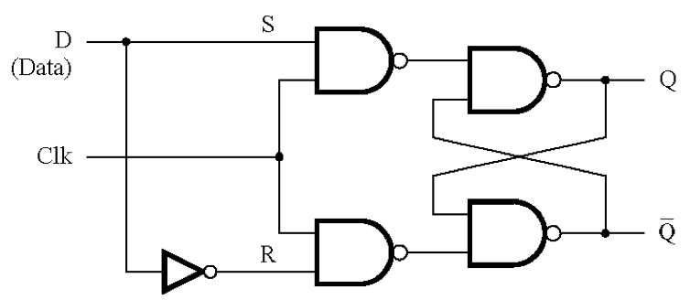
Circuit Diagram for the Gated D Latch
[ Figure 5.7a from the textbook ]

Slide 33
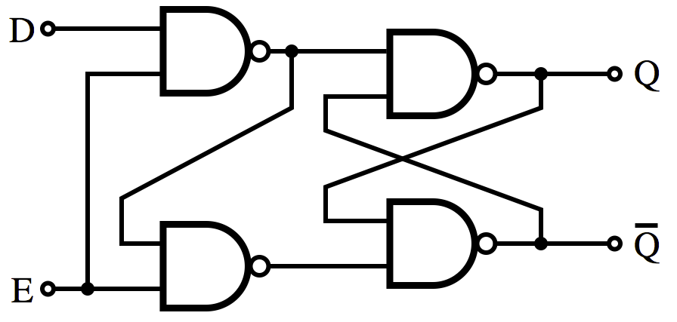
Gated D Latch: Alternative Design
Clk
[https://en.wikipedia.org/wiki/Flip-flop_(electronics)]

Slide 34
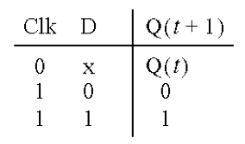
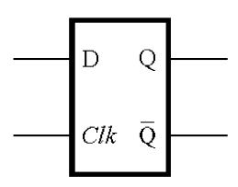
Gated D Latch: Circuit Diagram, Characteristic Table, and Graphical Symbol
Note that it is now impossible to have S=R=1.
When Clk=1 the output follows the D input.
When Clk=0 the output cannot be changed.
[ Figure 5.7a,b from the textbook ]

Slide 35
Setup and hold times for Gated D latch
t
su
t
h
Clk
D
Q
Setup time (t_{su}) – the minimum time that the D signal must be stable
prior to the the negative edge of the Clock signal
Hold time (t_{h}) – the minimum time that the D signal must remain stable
after the the negative edge of the Clock signal
[ Figure 5.8 from the textbook ]

Slide 36
Master-Slave D Flip-Flop

Slide 37
Constructing a Master-Slave D Flip-Flop
From Two D Latches
Master
Slave

Slide 38
Constructing a Master-Slave D Flip-Flop
From Two D Latches
Master
Slave

Slide 39
Constructing a Master-Slave D Flip-Flop
From Two D Latches
Master
Slave

Slide 40
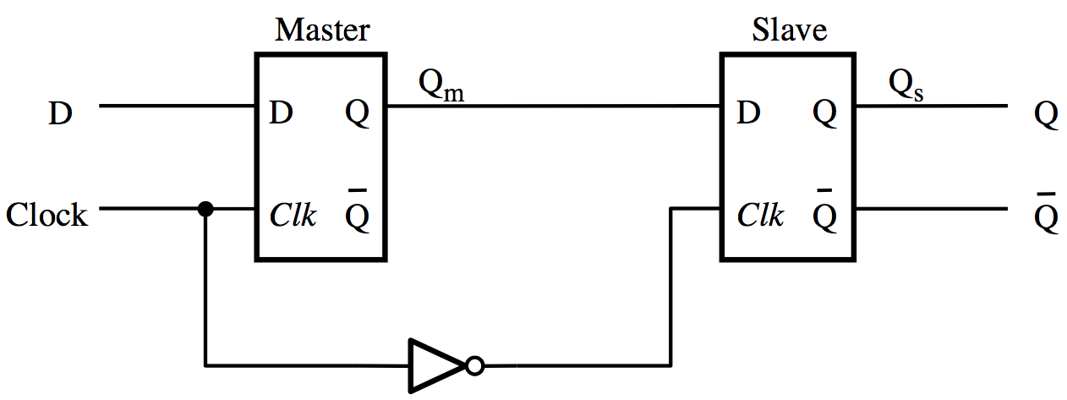
Constructing a Master-Slave D Flip-Flop
From Two D Latches
[ Figure 5.9a from the textbook ]

Slide 41
Constructing a Master-Slave D Flip-Flop
From one D Latch and one Gated SR Latch
(This version uses one less NOT gate)
Master
Slave

Slide 42
Constructing a Master-Slave D Flip-Flop
From one D Latch and one Gated SR Latch
(This version uses one less NOT gate)
Master
Slave

Slide 43
Edge-Triggered D Flip-Flops

Slide 44
Master-Slave D Flip-Flop
Master
Slave
Q
m
Q
D
D
Q
D
Q
s
Q
Clock
Clk
Q
Clk
Q
Q
(a) Circuit
[ Figure 5.9a from the textbook ]

Slide 45
Negative-Edge-Triggered Master-Slave D Flip-Flop
Master
Slave
Q
m
Q
D
D
Q
D
Q
s
Q
Clock
Clk
Q
Clk
Q
Q
Positive-Edge-Triggered Master-Slave D Flip-Flop
Master
Slave
Q
m
Q
D
D
Q
D
Q
s
Q
Clock
Clk
Q
Clk
Q
Q

Slide 46
Negative-Edge-Triggered Master-Slave D Flip-Flop
Master
Slave
Q
m
Q
D
D
Q
D
Q
s
Q
Clock
Clk
Q
Clk
Q
Q
Positive-Edge-Triggered Master-Slave D Flip-Flop
Master
Slave
Q
m
Q
D
D
Q
D
Q
s
Q
Clock
Clk
Q
Clk
Q
Q

Slide 47
Negative-Edge-Triggered Master-Slave D Flip-Flop
Master
Slave
Q
m
Q
D
D
Q
D
Q
s
Q
D
Q
Clock
Clk
Q
Clk
Q
Q
Q
Positive-Edge-Triggered Master-Slave D Flip-Flop
Master
Slave
Q
m
Q
Q
D
D
Q
D
Q
s
Q
D
Clock
Clk
Q
Clk
Q
Q
Q

Slide 48
T Flip-Flop

Slide 49
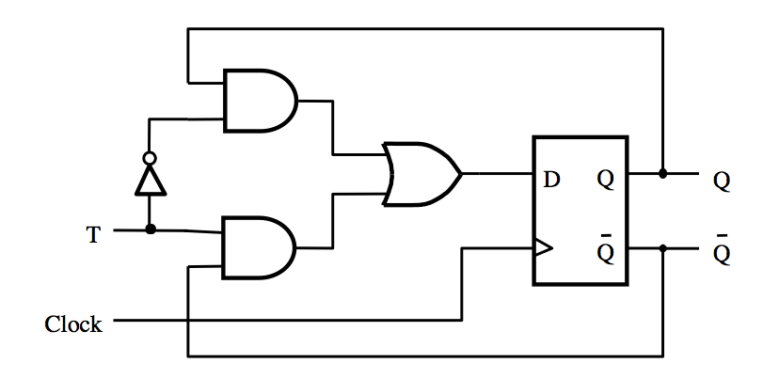
T Flip-Flop
[ Figure 5.15a from the textbook ]

Slide 50
T Flip-Flop
Positive-edge-triggered
D Flip-Flop
[ Figure 5.15a from the textbook ]

Slide 51
T Flip-Flop
What is this?
[ Figure 5.15a from the textbook ]

Slide 52
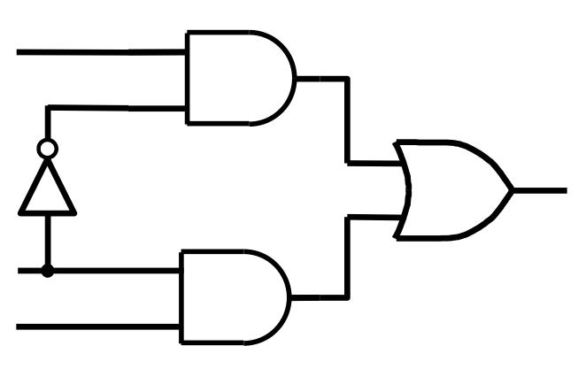
What is this?
Q
D
T
Q

Slide 53
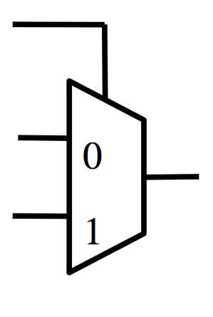
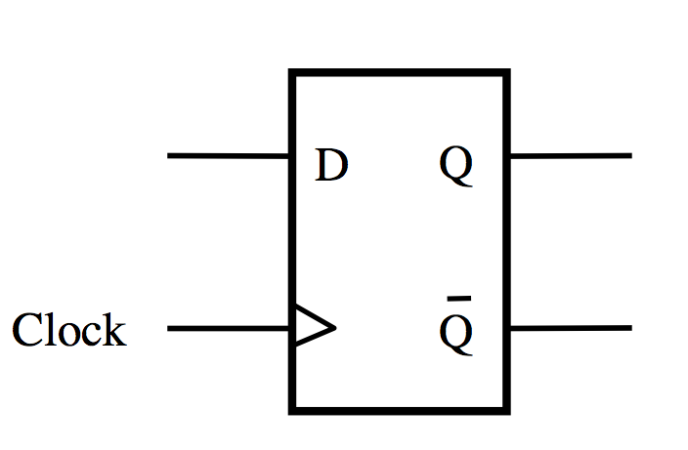
What is this?
T
Q
+
= ?
D
Q

Slide 54
T Flip-Flop
T
0
D
Q
1
Clock
Q

Slide 55
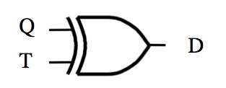
What is this?
+
= ?

Slide 56
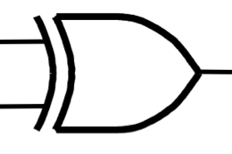
T Flip-Flop
T
D
Q
Clock
Q

Slide 57
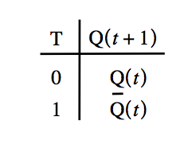
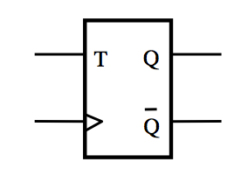
T Flip-Flop
(circuit, truth table and graphical symbol)
[ Figure 5.15a-c from the textbook ]

Slide 58
T Flip-Flop
(How it Works)
If T=0 then it stays in its current state
If T=1 then it reverses its current state
In other words the circuit “toggles” its state
when T=1. This is why it is called T flip-flop.

Slide 59
JK Flip-Flop

Slide 60
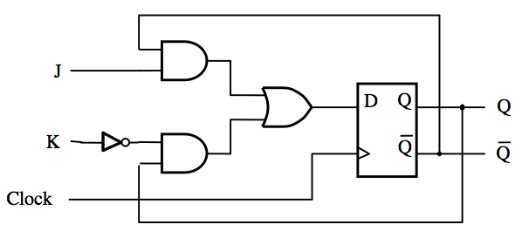
JK Flip-Flop
D = JQ + KQ
[ Figure 5.16a from the textbook ]

Slide 61
JK Flip-Flop
J
D
Q
Q
K
Q
Q
Clock
(a) Circuit
J
K
Q
(
t
+
1
)
0
0
Q
(
t
)
J
Q
0
1
0
1
0
1
K
Q
1
1
Q
(
t
)
(b) Truth table
(c) Graphical symbol
[ Figure 5.16 from the textbook ]

Slide 62
JK Flip-Flop
(How it Works)
A versatile circuit that can be used both as a SR flip-flop and as a T flip flop
If J=0 and S =0 it stays in the same state
Just like SR It can be set and reset
J=S and K=R
If J=K=1 then it behaves as a T flip-flop

Slide 63
Registers

Slide 64
Register
(Definition)
An n-bit structure consisting of flip-flops

Slide 65
Parallel-Access Register

Slide 66
1-Bit Parallel-Access Register
Load
0
D
Q
Out
In
1
Q
Clock

Slide 67
1-Bit Parallel-Access Register
Load
0
D
Q
Out
In
1
Q
Clock
The 2-to-1 multiplexer is used to select whether to load a new value into the D flip-flop or to retain the old value.
The output of this circuit is the Q output of the flip-flop.

Slide 68
1-Bit Parallel-Access Register
Load
0
D
Q
Out
In
1
Q
Clock
If Load = 0, then retain the old value.
If Load = 1, then load the new value from In.

Slide 69
2-Bit Parallel-Access Register
Out_1
Out_0
Load
0
0
D
Q
D
Q
1
1
Q
Q
Clock
In_1
In_0

Slide 70
2-Bit Parallel-Access Register
Parallel Output
Out_1
Out_0
Load
0
0
D
Q
D
Q
1
1
Q
Q
Clock
In_1
In_0
Parallel Input

Slide 71
3-Bit Parallel-Access Register
Out_2
Out_1
Out_0
Load
0
0
0
D
Q
D
Q
D
Q
1
1
1
Q
Q
Q
Clock
In_2
In_1
In_0
Notice that all flip-flops are on the same clock cycle.

Slide 72
3-Bit Parallel-Access Register
Parallel Output
Out_2
Out_1
Out_0
Load
0
0
0
D
Q
D
Q
D
Q
1
1
1
Q
Q
Q
Clock
In_2
In_1
In_0
Parallel Input

Slide 73
4-Bit Parallel-Access Register
Out_3
Out_2
Out_1
Out_0
Load
0
0
0
0
D
Q
D
Q
D
Q
D
Q
1
1
1
1
Q
Q
Q
Q
Clock
In_3
In_2
In_1
In_0

Slide 74
4-Bit Parallel-Access Register
Parallel Output
Out_3
Out_2
Out_1
Out_0
Load
0
0
0
0
D
Q
D
Q
D
Q
D
Q
1
1
1
1
Q
Q
Q
Q
Clock
In_3
In_2
In_1
In_0
Parallel Input

Slide 75
Shift Register

Slide 76
A simple shift register
Q
Q
Q
Q
In
D
Q
1
D
Q
2
D
Q
3
D
Q
4
Out
Clock
Q
Q
Q
Q
[ Figure 5.17a from the textbook ]

Slide 77
A simple shift register
Q
Q
Q
Q
In
D
Q
1
D
Q
2
D
Q
3
D
Q
4
Out
Clock
Q
Q
Q
Q
Positive-edge-triggered
D Flip-Flop

Slide 78
A simple shift register
Q
Q
Q
Q
In
D
Q
1
D
Q
2
D
Q
3
D
Q
4
Out
Clock
Q
Q
Q
Q
Master
Slave
Q
m
Q
D
D
Q
D
Q
s
Q
Clock
Clk
Q
Clk
Q
Q

Slide 79
A simple shift register
Q
Q
Q
Q
In
D
Q
1
D
Q
2
D
Q
3
D
Q
4
Out
Clock
Q
Q
Q
Q
D –Flip-Flop
Master
Slave
Q
m
Q
D
D
Q
D
Q
s
Q
Clock
Clk
Q
Clk
Q
Q
Gated D-Latch
Gated D-Latch

Slide 80
A simple shift register
Q
Q
Q
Q
In
D
Q
1
D
Q
2
D
Q
3
D
Q
4
Out
Clock
Q
Q
Q
Q

Slide 81
A simple shift register
Q
Q
Q
Q
In
D
Q
1
D
Q
2
D
Q
3
D
Q
4
Out
Clock
Q
Q
Q
Q
Master
Slave
Master
Slave
Master
Slave
Master
Slave
In
D
Q
D
Q
D
Q
D
Q
D
Q
D
Q
D
Q
D
Q
Clock
Q
Q
Q
Q
Clk
Q
Clk
Q
Clk
Q
Clk
Q
Clk
Clk
Clk
Clk

Slide 82
A simple shift register
Q
Q
Q
Q
In
D
Q
1
D
Q
2
D
Q
3
D
Q
4
Out
Clock
Q
Q
Q
Q
Master
Slave
Master
Slave
Master
Slave
Master
Slave
In
D
Q
D
Q
D
Q
D
Q
D
Q
D
Q
D
Q
D
Q
Clock
Q
Q
Q
Q
Clk
Q
Clk
Q
Clk
Q
Clk
Q
Clk
Clk
Clk
Clk

Slide 83
A simple shift register
Q
Q
Q
Q
In
D
Q
1
D
Q
2
D
Q
3
D
Q
4
Out
Clock
Q
Q
Q
Q
Master
Slave
Master
Slave
Master
Slave
Master
Slave
In
D
Q
D
Q
D
Q
D
Q
D
Q
D
Q
D
Q
D
Q
Clock
Q
Q
Q
Q
Clk
Q
Clk
Q
Clk
Q
Clk
Q
Clk
Clk
Clk
Clk

Slide 84
A simple shift register
Q
Q
Q
Q
In
D
Q
1
D
Q
2
D
Q
3
D
Q
4
Out
Clock
Q
Q
Q
Q
Master
Slave
Master
Slave
Master
Slave
Master
Slave
In
D
Q
D
Q
D
Q
D
Q
D
Q
D
Q
D
Q
D
Q
Clock
Q
Q
Q
Q
Clk
Q
Clk
Q
Clk
Q
Clk
Q
Clk
Clk
Clk
Clk

Slide 85
A simple shift register
Q
Q
Q
Q
In
D
Q
1
D
Q
2
D
Q
3
D
Q
4
Out
Clock
Q
Q
Q
Q
Master
Slave
Master
Slave
Master
Slave
Master
Slave
In
D
Q
D
Q
D
Q
D
Q
D
Q
D
Q
D
Q
D
Q
Clock
Q
Q
Q
Q
Clk
Q
Clk
Q
Clk
Q
Clk
Q
Clk
Clk
Clk
Clk

Slide 86
A simple shift register
Master
Slave
Master
Slave
Master
Slave
Master
Slave
In
D
Q
D
Q
D
Q
D
Q
D
Q
D
Q
D
Q
D
Q
Clock
Q
Q
Q
Q
Clk
Q
Q
Clk
Q
Q
Clk
Clk
Clk
Clk
Clk
Clk

Slide 87
A simple shift register
Q
Q
Q
Q
In
D
Q
1
D
Q
2
D
Q
3
D
Q
4
Out
Clock
Q
Q
Q
Q
(a) Circuit
In
Q
Q
Q
Q
=
Out
1
2
3
4
t
1
0
0
0
0
0
t
0
1
0
0
0
1
t
1
0
1
0
0
2
t
1
1
0
1
0
3
t
1
1
1
0
1
4
t
0
1
1
1
0
5
t
0
0
1
1
1
6
t
0
0
0
1
1
7
(b) A sample sequence
[ Figure 5.17 from the textbook ]

Slide 88
Parallel-Access Shift Register

Slide 89
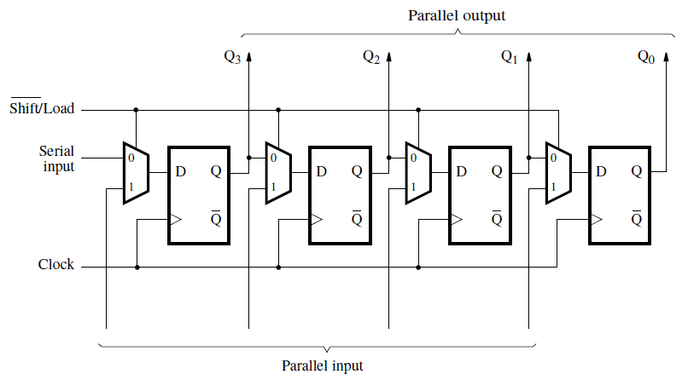
Parallel-access shift register
[ Figure 5.18 from the textbook ]

Slide 90
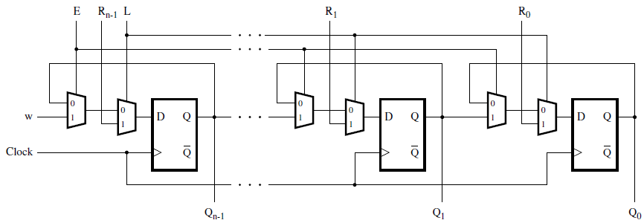
A shift register with parallel load and enable control inputs
[ Figure 5.59 from the textbook ]

Slide 91
Register File

Slide 92
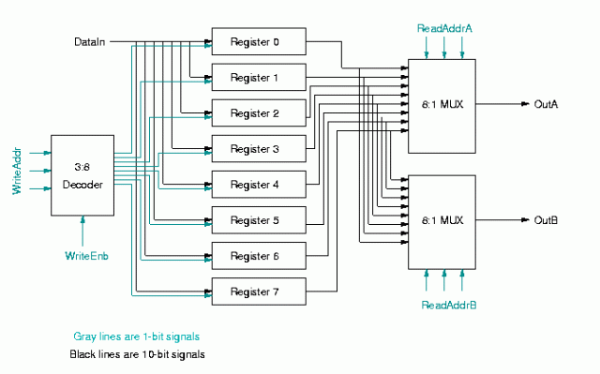
Register File
[https://jindongpu.wordpress.com/2012/03/07/register-file/]

Slide 93
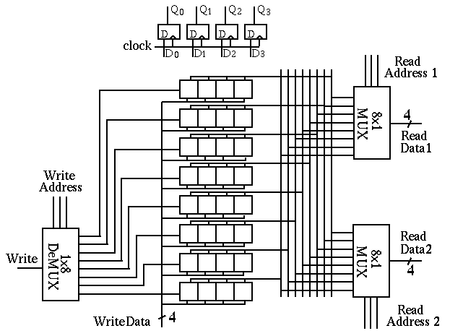
[http://fourier.eng.hmc.edu/e85_old/lectures/digital_logic/node19.html]

Slide 94
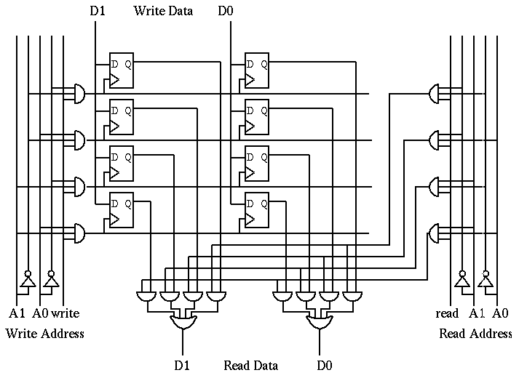
[http://fourier.eng.hmc.edu/e85_old/lectures/digital_logic/node19.html]
Notes:
This is a more detailed diagram showing only 2 of the bits in 4 of the registers:

Slide 95
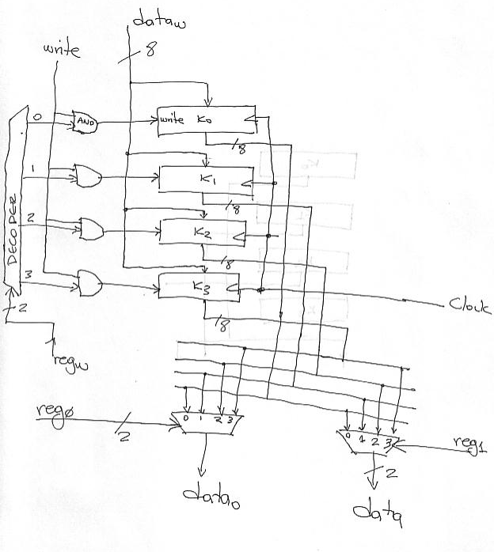
[http://www.eecg.toronto.edu/~enright/teaching/ece243S/notes/l19-implemenation-single-cycle.html]

Slide 96
Register File
Register file is a unit containing r registers
  r can be 4, 8, 16, 32, etc.
Each register has n bits
  n can be 4, 8, 16, 32, etc.
  n defines the data path width
Output ports (DATA1 and DATA2) are used for reading the register file
  Any register can be read from any of the ports
  Each port needs a log₂r bits to specify the read address (RA1 and RA2)
Input port (LD_DATA) is used for writing data to the register file
  Write address is also specified by log₂r bits (WA)
  Writing is enabled by a 1-bit signal (WR)
RA1
RA2
Reg
File
DATA1
LD_DATA
DATA2
WR
WA

Slide 97
Register File: Exercise
Suppose that a register file
  contains 32 registers
  width of data path is 16 bits
  (i.e., each register has 16 bits)
How many bits are there for each of the signals?
  RA1
  RA2
  DATA1
  DATA2
  WA
  LD_DATA
  WR
RA1
RA2
Reg
File
DATA1
LD_DATA
DATA2
WR
WA
5
5
16
16
5
16
1

Slide 98
Register file design
We will design an eight-register file with 4-bit wide registers
A single 4-bit register and its abstraction are shown below
We have to use eight such registers to make an eight register file
How many bits are required to specify a register address?
LD
D3
D2
D1
D0
LD
1
0
Q3
1
0
Q2
1
0
Q1
1
0
Q0
D3 D2 D1 D0
D
Q
D
Q
D
Q
D
Q
Q3 Q2 Q1 Q0
P
P
P
P
Clock
Clock
LD
LD
LD
D3 D2 D1 D0
D3 D2 D1 D0
D3 D2 D1 D0
Q3 Q2 Q1 Q0
Q3 Q2 Q1 Q0
Q3 Q2 Q1 Q0
Clk
Clk
Clk

Slide 99
Reading Circuit
A 3-bit register address, RA, specifies which register is to be read
For each output port, we need one 8-to-1 4-bit multiplier
Register
Address
111
001
000
LD7
LD1
LD0
D3 D2 D1 D0
D3 D2 D1 D0
D3 D2 D1 D0
Q3 Q2 Q1 Q0
Q3 Q2 Q1 Q0
Q3 Q2 Q1 Q0
Clk
Clk
Clk
7 6 5 4 3 2 1 0
8-to-1 4-bit multiplex
7 6 5 4 3 2 1 0
8-to-1 4-bit multiplex
RA1
RA2
DATA1
DATA2

Slide 100
Adding write control to register file
To write to any register, we need the register's address (WA) and a write register signal (WR)
A 3-bit write address is decoded if write register signal is present
One of the eight registers gets a LD signal from the decoder
LD_DATA
WA
LD7
LD1
LD0
D3 D2 D1 D0
D3 D2 D1 D0
D3 D2 D1 D0
3
to
8
D
e
c
o
d
e
r
LD7
111
001
000
Q3 Q2 Q1 Q0
Q3 Q2 Q1 Q0
Q3 Q2 Q1 Q0
Clk
Clk
Clk
LD2
LD1
7 6 5 4 3 2 1 0
8-to-1 4-bit multiplex
7 6 5 4 3 2 1 0
8-to-1 4-bit multiplex
LD0
RA1
RA2
WR
DATA1
DATA2

Slide 101
Questions?

Slide 102
THE END

